Slide 1
AI – IA 2
Agentic AI
Dr. Ayesha Hakim

Slide 2
Agentic AI: Extending Classical AI Agents
In classical AI, we study intelligent agents
  Perceive environment
  Make decisions
  Perform actions
Agentic AI is a modern implementation of the same idea
Difference:
  Classical AI → theory & algorithms
  Agentic AI → Practical, real-world execution
Agentic AI focuses on:
  Goal-based behavior
  Planning & reasoning
  Tool usage
  Iterative decision making
Agentic AI = Classical AI agents + modern AI tools

Slide 3
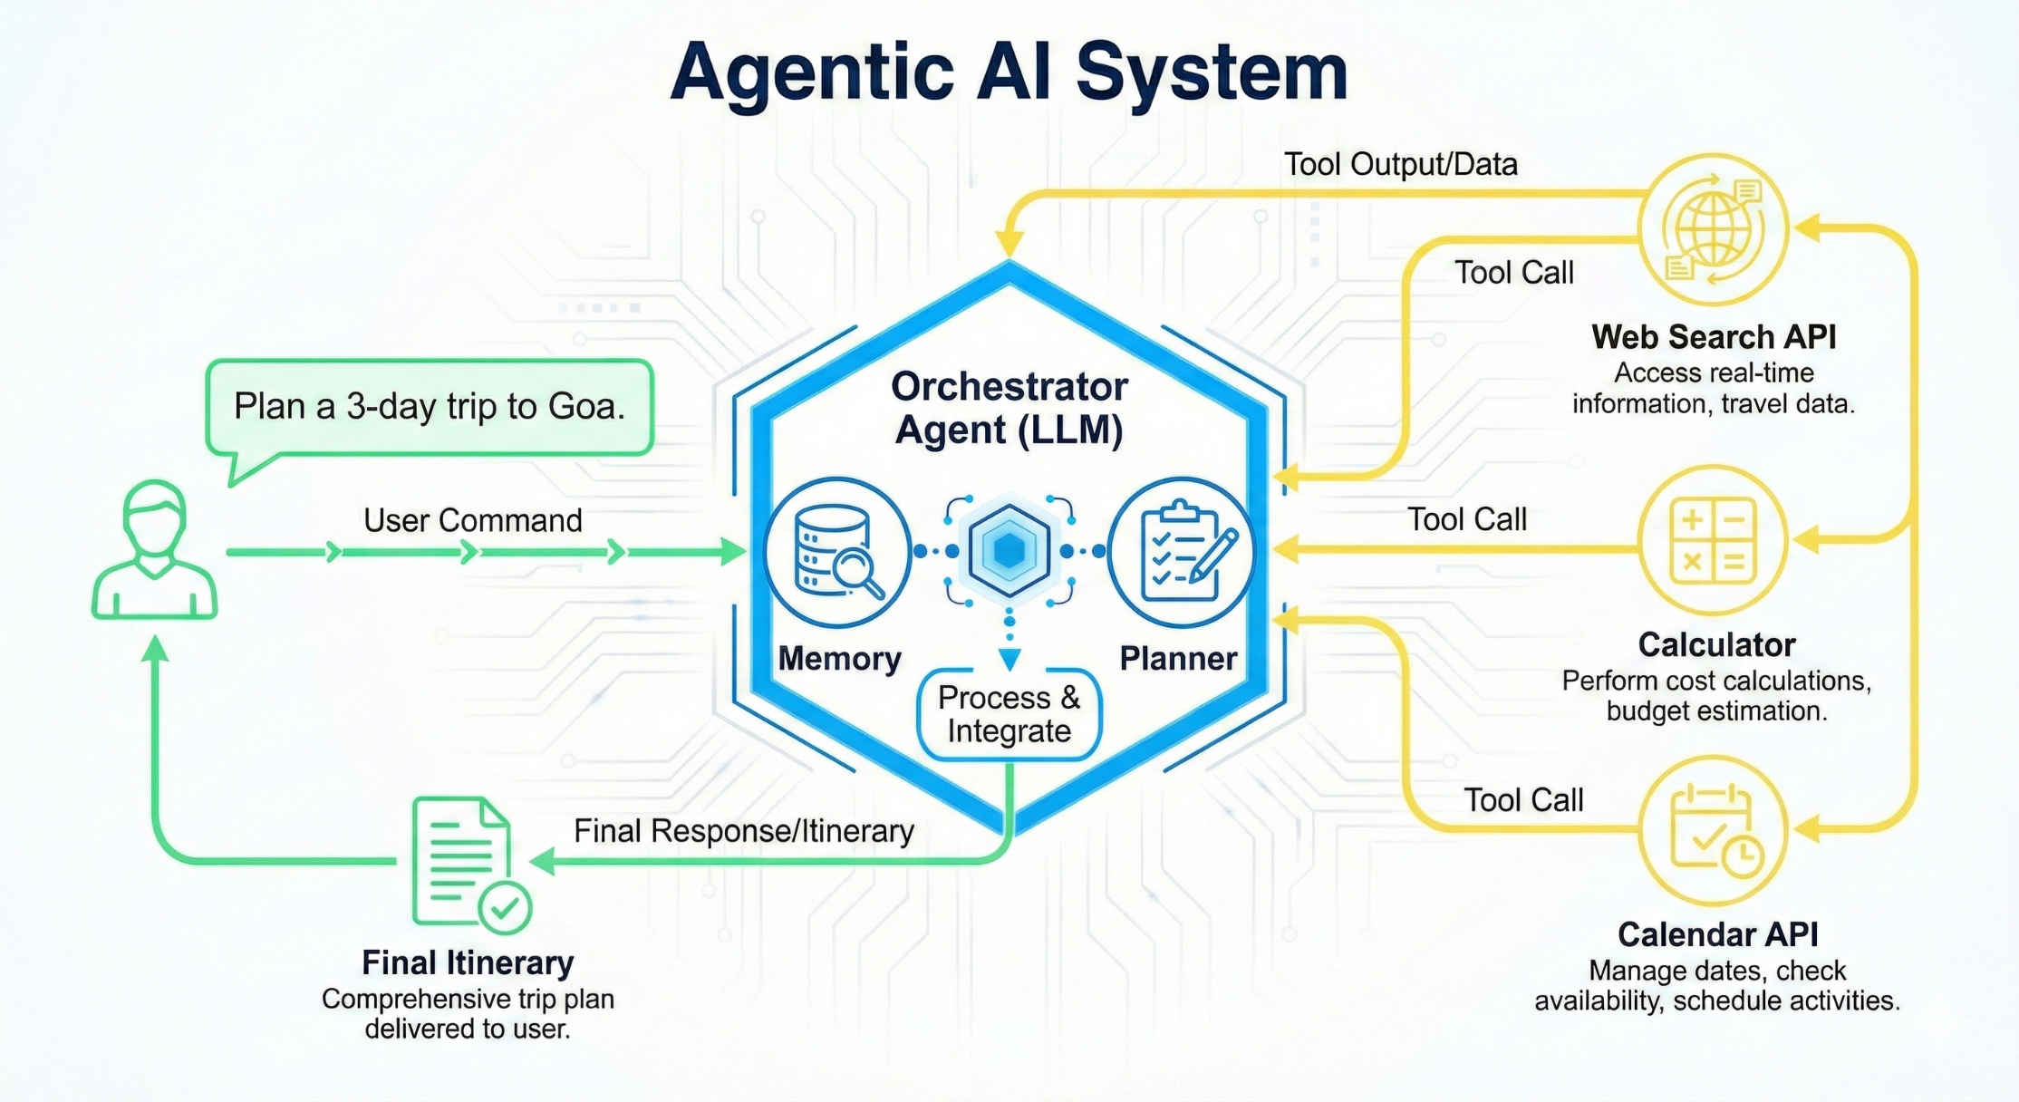
Agentic AI System Architecture

Slide 4
Agentic AI Workflow
User Goal
  User provides a goal, not a single command
  Example: “Plan a 3-day trip to Goa”
Reasoning & Planning
  Agent breaks goal into sub-tasks
  Decides sequence of actions
Tool Use
  Agent uses tools when needed
  Web search, calculator, calendar
Loop & Result
  Agent evaluates results
  Repeats planning if required
  Produces final complete output

Slide 5
Agentic AI System Architecture
Orchestrator Agent (LLM)
  Acts as the controller
  Coordinates reasoning and actions
Planner
  Decides what to do first, next, and last
Memory
  Stores intermediate results and context
Tool APIs
  Web Search → information
  Calculator → numeric computation
  Calendar → scheduling
Final Output
  Goal-complete response

Slide 6
Students Activity
In this activity, you will:
Define a user goal
Describe how the agent plans the task
Identify which tools the agent uses
Explain the loop and final output

Slide 7
AI Tools & Frameworks for Agentic AI Activity
Agent Frameworks (Choose ONE)
AutoGen
  Multi-agent conversation framework
  Agents communicate to solve tasks
CrewAI
  Role-based agents (Planner, Executor, Reviewer)
  Clear task delegation
ReAct-style Agents
  Reasoning + Action + Observation loop
  Simple and well-aligned with AI syllabus
BrowserUse
  Agent interacts with browser/webpages
  Useful for research and data collection
OpenRouter (Free API)
  Access to open-source LLMs
  No paid subscription required
LangChain
  Framework for building LLM-powered applications
  Provides agent orchestration
  Supports tool integration (APIs, search, databases)
  Implements ReAct-style reasoning loop

Slide 8
AI Tools & Frameworks for Agentic AI Activity
Tools Integrated with Agents (Choose at least ONE)
Web Search APIs
Calculator tools
Google OAuth 2.0 (Google Calendar tasks)
File / document readers (PDF, text)
Simple databases (CSV / JSON)
Python tools (basic scripting, data processing)
Focus is on agent behavior and reasoning, not model training.

Slide 9
Example Problem Statements
Research Assistant Agent
  Reads documents (PDF / text files)
  Uses tools to retrieve information
  Answers user questions based on content
Google Calendar Scheduling Agent
  Takes meeting details as input
  Uses Google Calendar API
  Automatically schedules the meeting
Academic Planner Agent
  Creates a study schedule
  Considers constraints (subjects, time, deadlines)
  Adjusts plan dynamically
Healthcare Information Agent (Non-Diagnostic)
  Collects user symptoms (text input)
  Retrieves medical guidelines using web search
  Does NOT provide diagnosis

Slide 10
Example Problem Statements
Job Application Assistant Agent
  Analyzes Resume + Job Description
  Identifies gaps
  Suggests improvements
Travel Planning Agent
  Plans itinerary for a trip
  Uses web search for places, costs
  Applies reasoning to optimize plan
Each solution must demonstrate Goal → Plan → Tool Use → Final Output.
“You are not building an AI model. You are designing an intelligent agent that can reason, plan, and use modern AI tools to achieve a goal.”

Slide 11
References
Agentic AI Tutorial for Beginners | Langgraph Tutorial
Agents and Agentic Frameworks
Best Agentic AI Framework
Part 1 : ReACT AI Agents: A Guide to Smarter AI Through Reasoning and Action. | by Gauri | Medium
Build Your First AI Agent in 20 Minutes (No Coding Required)

